Slide 1
GraphQL
Introduction

Slide 2
What is GraphQL?
Is an API Query Language developed and open-sourced by Facebook that provides a more efficient, powerful and flexible alternative to REST
Enables declarative data fetching where a client can specify exactly the data that is needed from an API.
GraphQL servers exposes a single endpoint

Slide 3
History
Facebook started using GraphQL in 2012 for their native mobile apps
The first time Facebook publicly spoke about GraphQL was at React.js Conf 2015
It was believed it was a limited to use only with React
Netflix implemented Falcor
Coursera cancelled their project to use GraphQL

Slide 4
GraphQL
GraphQL vs. REST

Slide 5
A more efficient alternative to REST
When REST concept was developed, client application were relatively simple
REST was a good fit for many applications
API landscape has radically changed over the years
Three factors that have been challenging the way APIs are designed
Notes:
REST has been a popular way to expose data from a server. When the concept of REST was developed, client applications were relatively simple and the development pace wasn’t nearly where it is today. REST thus was a good fit for many applications. However, the API landscape has radically changed over the last couple of years. In particular, there are three factors that have been challenging the way APIs are designed:

Slide 6
1. Increased mobile usage creates need for efficient data loading
Increased mobile usage, low-powered devices and sloppy networks were the initial reasons
GraphQL minimizes the amount of data that needs to be transferred
Majorly improves applications operating under these conditions
Notes:
1. Increased mobile usage creates need for efficient data loading
Increased mobile usage, low-powered devices and sloppy networks were the initial reasons why Facebook developed GraphQL. GraphQL minimizes the amount of data that needs to be transferred over the network and thus majorly improves applications operating under these conditions.

Slide 7
2. Variety of different frontend frameworks and platforms
Difficulty to build and maintain one API that would fit the requirements of all
GraphQL allows each client to access precisely to the data they need.
Notes:
2. Variety of different frontend frameworks and platforms
The heterogeneous landscape of frontend frameworks and platforms that run client applications makes it difficult to build and maintain one API that would fit the requirements of all. With GraphQL, each client can access precisely the data it needs.

Slide 8
3. Fast development & expectation for rapid feature development
Continuous deployment has become a standard
Rapid iterations and frequent product updates are indispensable
REST
The way data is exposed often needs to be modified
Notes:
3. Fast development & expectation for rapid feature development
Continuous deployment has become a standard for many companies, rapid iterations and frequent product updates are indispensable. With REST APIs, the way data is exposed by the server often needs to be modified to account for specific requirements and design changes on the client-side. This hinders fast development practices and product iterations.

Slide 9
REST
Scenario
GraphQL
Has become the standard for designing web APIs
Stateless servers
Structured access to resources
Inflexible to keep up with the rapidly changing requirements of the clients
In a blogging application, an app needs to display the titles of the posts of a specific user. The same screen also displays the names of the last 3 followers of that user.
Stateless
Solves shortcomings
More efficient
Notes:
Over the past decade, REST has become the standard (yet a fuzzy one) for designing web APIs. It offers some great ideas, such as stateless servers and structured access to resources. However, REST APIs have shown to be too inflexible to keep up with the rapidly changing requirements of the clients that access them.
GraphQL was developed to cope with the need for more flexibility and efficiency! It solves many of the shortcomings and inefficiencies that developers experience when interacting with REST APIs.

Slide 10
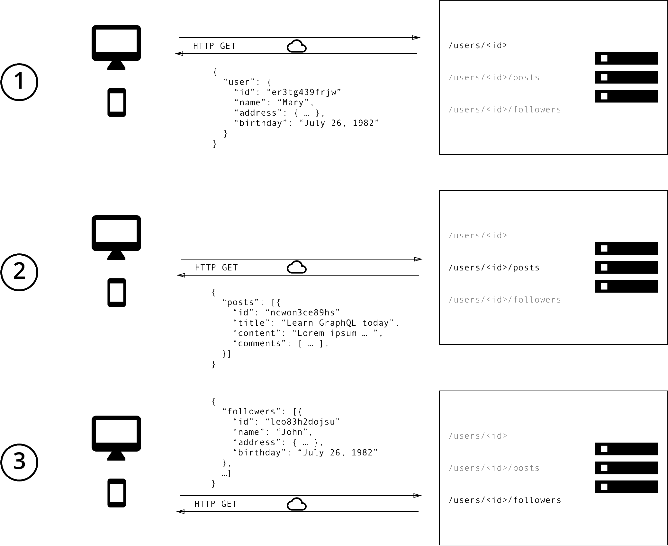
Data Fetching - REST
Three requests to different endpoints to fetch the required data.
Overfetching, since the endpoints return additional information that is not needed.
Notes:
With a REST API, you would typically gather the data by accessing multiple endpoints. In the example, these could be /users/<id> endpoint to fetch the initial user data. Secondly, there’s likely to be a /users/<id>/posts endpoint that returns all the posts for a user. The third endpoint will then be the /users/<id>/followers that returns a list of followers per user. https://www.howtographql.com/basics/1-graphql-is-the-better-rest/

Slide 11
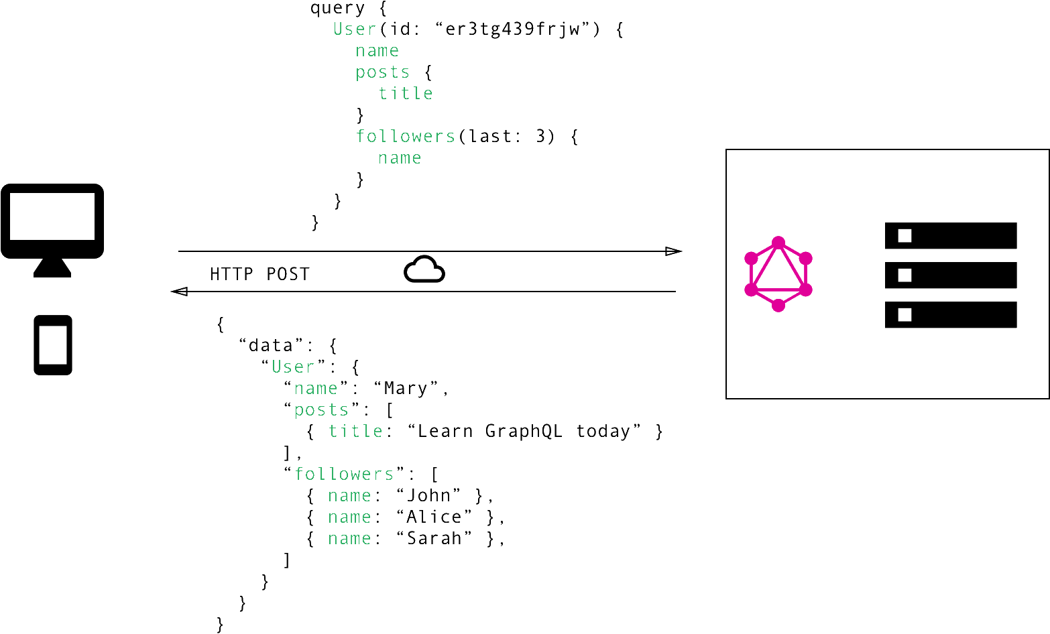
Data Fetching - GraphQL
The client can specify exactly the data it needs in a query.
The structure of the server’s response follows the nested structure defined in the query.
Notes:
In GraphQL on the other hand, you’d simply send a single query to the GraphQL server that includes the concrete data requirements. The server then responds with a JSON object where these requirements are fulfilled.

Slide 12
No more Over- and Underfetching
Overfetching: when the client downloads more information than is actually required.
Underfetching:
Endpoint does not provides enough of the required information.
The client will have to make additional requests
Situation where a client needs a list of elements and one more request per element to fetch required data
Notes:
One of the most common problems with REST is that of over- and underfetching. This happens because the only way for a client to download data is by hitting endpoints that return fixed data structures. It’s very difficult to design the API in a way that it’s able to provide clients with their exact data needs.
“Think in graphs, not endpoints.” Lessons From 4 Years of GraphQL by Lee Byron, GraphQL Co-Inventor.
Overfetching: Downloading superfluous data
Overfetching means that a client downloads more information than is actually required in the app. Imagine for example a screen that needs to display a list of users only with their names. In a REST API, this app would usually hit the /users endpoint and receive a JSON array with user data. This response however might contain more info about the users that are returned, e.g. their birthdays or addresses - information that is useless for the client because it only needs to display the users’ names.
Underfetching and the n+1 problem
Another issue is underfetching and the n+1-requests problem. Underfetching generally means that a specific endpoint doesn’t provide enough of the required information. The client will have to make additional requests to fetch everything it needs. This can escalate to a situation where a client needs to first download a list of elements, but then needs to make one additional request per element to fetch the required data.
As an example, consider the same app would also need to display the last three followers per user. The API provides the additional endpoint /users/<user-id>/followers. In order to be able to display the required information, the app will have to make one request to the /users endpoint and then hit the /users/<user-id>/followers endpoint for each user.

Slide 13
Rapid Product Iterations on the Frontend
Structure REST APIs endpoint according to the views
Does not allow rapid iterations on the frontend
High risk that there is more (or less) data required.
With GraphQL, changes on client-side can be done without extra work
Clients specify their exact data requirements
No backend adjustments
Notes:
A common pattern with REST APIs is to structure the endpoints according to the views that you have inside your app. This is handy since it allows for the client to get all required information for a particular view by simply accessing the corresponding endpoint.
The major drawback of this approach is that it doesn’t allow for rapid iterations on the frontend. With every change that is made to the UI, there is a high risk that now there is more (or less) data required than before. Consequently, the backend needs to be adjusted as well to account for the new data needs. This kills productivity and notably slows down the ability to incorporate user feedback into a product.
With GraphQL, this problem is solved. Thanks to the flexible nature of GraphQL, changes on the client-side can be made without any extra work on the server. Since clients can specify their exact data requirements, no backend engineer needs to make adjustments when the design and data needs on the frontend change.

Slide 14
Insightful Analytics on the Backend
Allows you to have fine-grained insights about the data that’s requested on the backend
It can help in evolving an API and deprecating specific fields that are not requested anymore
Low-level performance monitoring of requests.
Instrumenting and measuring performance of resolver functions for bottlenecks.
Notes:
GraphQL allows you to have fine-grained insights about the data that’s requested on the backend. As each client specifies exactly what information it’s interested in, it is possible to gain a deep understanding of how the available data is being used. This can for example help in evolving an API and deprecating specific fields that are not requested by any clients any more.
With GraphQL, you can also do low-level performance monitoring of the requests that are processed by your server. GraphQL uses the concept of resolver functions to collect the data that’s requested by a client. Instrumenting and measuring performance of these resolvers provides crucial insights about bottlenecks in your system.

Slide 15
Benefits of a Schema & Type System
Uses a strong type system to define the capabilities of an API
All the types that are exposed in an API are written down in a schema using Schema Definition Language (SDL)
The Schema serves as the contract between the client and the server.
Easy to test applications by mocking data structures
Notes:
GraphQL uses a strong type system to define the capabilities of an API. All the types that are exposed in an API are written down in a schema using the GraphQL Schema Definition Language (SDL). This schema serves as the contract between the client and the server to define how a client can access the data.
Once the schema is defined, the teams working on frontend and backends can do their work without further communication since they both are aware of the definite structure of the data that’s sent over the network.
Frontend teams can easily test their applications by mocking the required data structures. Once the server is ready, the switch can be flipped for the client apps to load the data from the actual API.

Slide 16
GraphQL
Architecture

Slide 17
Architecture - Uses Cases
3 different architectures that include a GraphQL server
1 - GraphQL server with a connected database
2 - GraphQL server that is a thin layer in front of a number of third party or legacy systems and integrates them through a single GraphQL API
3 - A hybrid approach of a connected database and third party or legacy systems that can all be accessed through the same GraphQL API
Notes:
All three architectures represent major use cases of GraphQL and demonstrate the flexibility in terms of the context where it can be used.

Slide 18
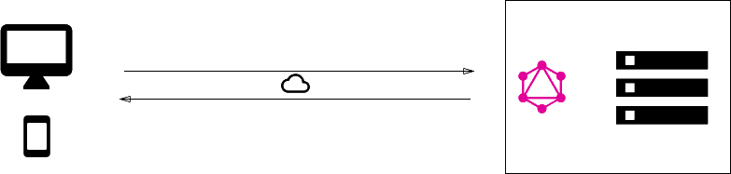
1. GraphQL server with a connected database
Single server that implements GraphQL specification
Server read the query’s payload and fetches the information from the DB (Resolving)
Constructs the response object and returns it to the client
Transport-layer agnostic (TCP, WebSockets)
Does not care about DB or stored data format
A standard greenfield architecture with one GraphQL server that connects to a single database.
Notes:
This architecture will be the most common for greenfield projects. In the setup, you have a single (web) server that implements the GraphQL specification. When a query arrives at the GraphQL server, the server reads the query’s payload and fetches the required information from the database. This is called resolving the query. It then constructs the response object as described in the official specification and returns it to the client.
It’s important to note that GraphQL is actually transport-layer agnostic. This means it can potentially be used with any available network protocol. So, it is potentially possible to implement a GraphQL server based on TCP, WebSockets, etc.
GraphQL also doesn’t care about the database or the format that is used to store the data. You could use a SQL database like AWS Aurora or a NoSQL database like MongoDB.

Slide 19
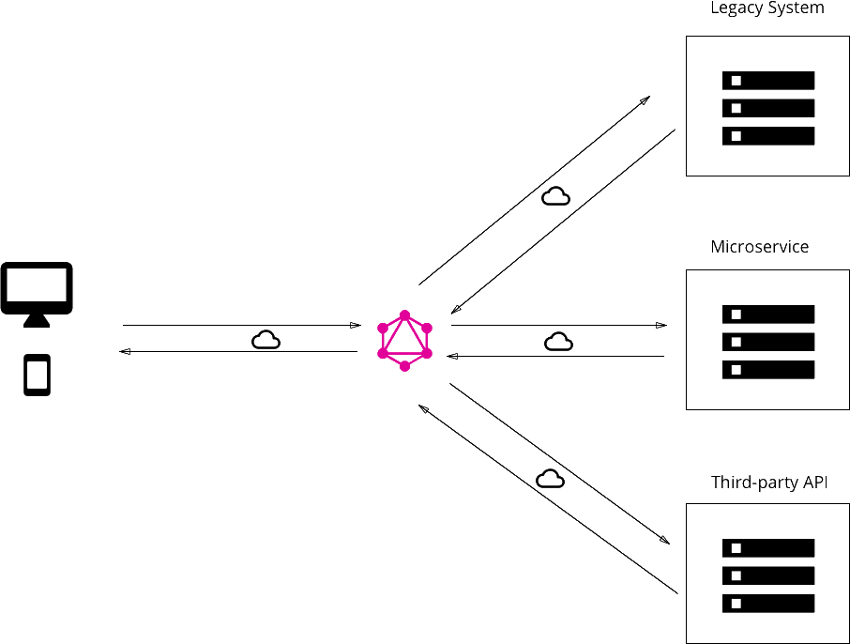
2. GraphQL layer that integrates existing systems
Legacy systems make practically impossible to build products that need access to multiple systems
Unify systems and hide complexity behind a GraphQL API
GraphQL does not care about the data sources to fetch needed data
Notes:
Another major use case for GraphQL is the integration of multiple existing systems behind a single, coherent GraphQL API. This is particularly compelling for companies with legacy infrastructures and many different APIs that have grown over years and now impose a high maintenance burden. One major problem with these legacy systems is that they make it practically impossible to build innovative products that need access to multiple systems.
In that context, GraphQL can be used to unify these existing systems and hide their complexity behind a nice GraphQL API. This way, new client applications can be developed that simply talk to the GraphQL server to fetch the data they need. The GraphQL server is then responsible for fetching the data from the existing systems and package it up in the GraphQL response format.
Just like in the previous architecture where the GraphQL server didn’t care about the type of database being used, this time it doesn’t care about the data sources that it needs to fetch the data that’s needed to resolve a query.

Slide 20
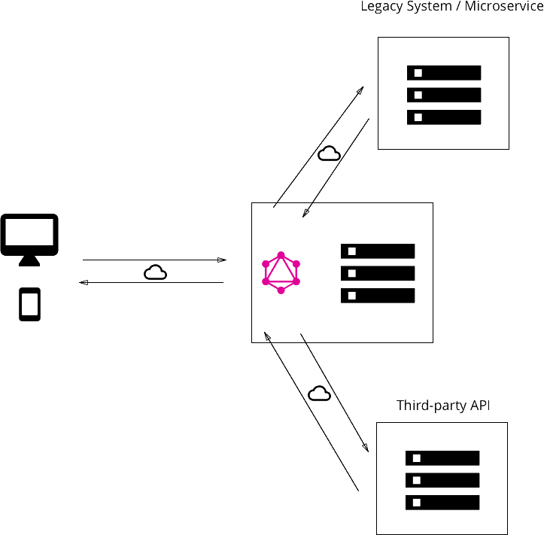
3. Hybrid approach with connected database and integration of existing system
Notes:
Finally, it’s possible to combine the two approaches and build a GraphQL server that has a connected database but still talks to legacy or third—party systems.
When a query is received by the server, it will resolve it and either retrieve the required data from the connected database or some of the integrated APIs.

Slide 21
How do we gain this flexibility with GraphQL?
The payload of a GraphQL query (or mutation) consists of a set of fields
In the GraphQL server implementation each of these fields actually corresponds to exactly one function that’s called a resolver
The purpose of a resolver function is to fetch the data for its field
Notes:
But how do we gain this flexibility with GraphQL? How is it that it’s such a great fit for these very different kinds of use cases?
As you learned in the previous chapter, the payload of a GraphQL query (or mutation) consists of a set of fields. In the GraphQL server implementation, each of these fields actually corresponds to exactly one function that’s called a resolver. The sole purpose of a resolver function is to fetch the data for its field.

Slide 22
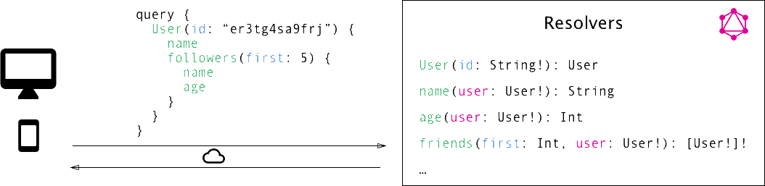
Resolver Functions
Notes:
When the server receives a query, it will call all the functions for the fields that are specified in the query’s payload. It thus resolves the query and is able to retrieve the correct data for each field. Once all resolvers returned, the server will package data up in the format that was described by the query and send it back to the client.

Slide 23
GraphQL
Core Concepts

Slide 24
The Schema Definition Language (SDL)
GraphQL has its own type system that’s used to define the schema of an API
type Person {
name: String!
age: Int!
posts: [Post!]!
}
type Post {
title: String!
author: Person!
}
Notes:
GraphQL has its own type system that’s used to define the schema of an API. The syntax for writing schemas is called Schema Definition Language (SDL).
Here is an example how we can use the SDL to define a simple type called Person:
type Person {
name: String!
age: Int!
}
This type has two fields, they’re called name and age and are respectively of type String and Int. The ! following the type means that this field is required.
It’s also possible to express relationships between types. In the example of a blogging application, a Person could be associated with a Post:
type Post {
title: String!
author: Person!
}
Conversely, the other end of the relationship needs to be placed on the Person type:
type Person {
name: String!
age: Int!
posts: [Post!]!
}
Note that we just created a one-to-many-relationship between Person and Post since the posts field on Person is actually an array of posts.

Slide 25
Basic Queries
Request
Response
{
"allPeople": [
{ "name": "Johnny" },
{ "name": "Sarah" },
{ "name": "Alice" }]
}
query{
allPeople {
name
}
}
Notes:
Let’s take a look at an example query that a client could send to a server:
allPeople Query
The allPersons field in this query is called the root field of the query. Everything that follows the root field, is called the payload of the query. The only field that’s specified in this query’s payload is name.
This query would return a list of all persons currently stored in the database. Here’s an example response:
allPeople Response
Notice that each person only has the name in the response, but the age is not returned by the server. That’s exactly because name was the only field that was specified in the query.
If the client also needed the persons’ age, all it has to do is slightly adjust the query and include the new field in the query’s payload:
{
allPersons {
name
age
}
}

Slide 26
Basic Queries
GraphQL also allows for naturally querying nested information
For example, loading all the posts that a Person has written:
Request
Response
{
allPeople {
name
age
posts {
title
}
}
}
"allPeople": [
{
"name": "Johnny",
"age": 23,
"posts": [{
"title": "GraphQL is awesome"
}]
},
...
Notes:
One of the major advantages of GraphQL is that it allows for naturally querying nested information. For example, if you wanted to load all the posts that a Person has written, you could simply follow the structure of your types to request this information:
Request
Queries with Arguments
In GraphQL, each field can have zero or more arguments if that’s specified in the schema. For example, the allPersons field could have a last parameter to only return up to a specific number of persons. Here’s what a corresponding query would look like:
{
allPersons(last: 2) {
name
}
}

Slide 27
Basic Queries
In GraphQL, each field can have zero or more arguments if that is specified in the schema.
For example, allPeolple field could have a “last” parameter to return a specific number of people:
Request
Response
"allPeople": [
{
"name": "Sarah"
},
{
"name": "Alice"
}
]
{
allPeople(last: 2) {
name
}
Notes:
Queries with Arguments
In GraphQL, each field can have zero or more arguments if that’s specified in the schema. For example, the allPersons field could have a last parameter to only return up to a specific number of persons. Here’s what a corresponding query would look like:
Request

Slide 28
Writing data with Mutations
Three kinds of mutations:
Create
Update
Delete
Mutations follow the same syntactical structure as queries, but they always need to start with the mutation keyword
Notes:
Next to requesting information from a server, the majority of applications also need some way of making changes to the data that’s currently stored in the backend. With GraphQL, these changes are made using so-called mutations. There generally are three kinds of mutations:
creating new data
updating existing data
deleting existing data
Mutations follow the same syntactical structure as queries, but they always need to start with the mutation keyword.

Slide 29
Writing data with Mutations
Request
Response
mutation{
createPerson(name: “Bob”, age: 36) {
name
age
}
}
"createPerson": {
"name": "Bob",
"age": 36
}
Notes:
Here’s an example for how we might create a new Person:
REQUEST
RESPONSE
Notice that similar to the query we wrote before, the mutation also has a root field - in this case it’s called createPerson. We also already learned about the concepts of arguments for fields. In this case, the createPerson field takes two arguments that specify the new person’s name and age.
Like with a query, we’re also able to specify a payload for a mutation in which we can ask for different properties of the new Person object. In our case, we’re asking for the name and the age - though admittedly that’s not super helpful in our example since we obviously already know them as we pass them into the mutation. However, being able to also query information when sending mutations can be a very powerful tool that allows you to retrieve new information from the server in a single roundtrip!
The server response for the above mutation would look as follows:
"createPerson": {
"name": "Bob",
"age": 36,
}

Slide 30
Writing data with Mutations
GraphQL types have unique IDs generated by the server.
type Person {
Id: ID!
name: String!
age: Int!
posts: [Post!]!
}
Request
Response
mutation{
createPerson(name: “Alice”, age: 36) {
id
}
}
"createPerson": {
"id": "ck1o9omiv0c2f0"
}
Notes:
One pattern you’ll often find is that GraphQL types have unique IDs that are generated by the server when new objects are created. Extending our Person type from before, we could add an id like this:
type Person {
id: ID!
name: String!
age: Int!
}
Now, when a new Person is created, you could directly ask for the id in the payload of the mutation, since that is information that wasn’t available on the client beforehand:
Request
RESPONSE

Slide 31
Realtime Updates with Subscriptions
Realtime connection to the server to get informed about important events
When a client subscribes to an event, it will initiate a steady connection to the server
Unlike queries and mutations that follow a typical “request-response-cycle” subscriptions represent a stream of data sent over to the client
Notes:
Another important requirement for many applications today is to have a realtime connection to the server in order to get immediately informed about important events. For this use case, GraphQL offers the concept of subscriptions.
When a client subscribes to an event, it will initiate and hold a steady connection to the server. Whenever that particular event then actually happens, the server pushes the corresponding data to the client. Unlike queries and mutations that follow a typical “request-response-cycle”, subscriptions represent a stream of data sent over to the client.

Slide 32
Realtime Updates with Subscriptions
Subscribing to an event
Server sends information
Opens a connection
subscription{
newPerson{
name
age
}
}
"newPerson": {
"name": "Jane",
"age": 23
}
Client listening
...
New person created data
Notes:
Subscriptions are written using the same syntax as queries and mutations. Here’s an example where we subscribe on events happening on the Person type:
subscription {
newPerson {
name
age
}
}
After a client sent this subscription to a server, a connection is opened between them. Then, whenever a new mutation is performed that creates a new Person, the server sends the information about this person over to the client:
{
"newPerson": {
"name": "Jane",
"age": 23
}
}

Slide 33
Defining a Schema
One of the most important concepts when working with GraphQL API.
It specifies the capabilities of the API and defines how clients can request data.
A schema is a collection of GraphQL types.
Root types:
type Query { ... }
type Mutation { ... }
type Subscription { ... }
Notes:
Now that you have a basic understanding of what queries, mutations, and subscriptions look like, let’s put it all together and learn how you can write a schema that would allow you to execute the examples you’ve seen so far.
The schema is one of the most important concepts when working with a GraphQL API. It specifies the capabilities of the API and defines how clients can request the data. It is often seen as a contract between the server and client.
Generally, a schema is simply a collection of GraphQL types. However, when writing the schema for an API, there are some special root types:
type Query { ... }
type Mutation { ... }
type Subscription { ... }
The Query, Mutation, and Subscription types are the entry points for the requests sent by the client.

Slide 34
Defining a Schema
type Query {
allPeople(last: Int): [Person!]!
}
type Mutation {
createPerson(name: String!, age: Int!): Person!
}
type Subscription {
newPerson: Person!
}
type Person {
name: String!
age: Int!
posts: [Post!]!
}
type Post {
title: String!
author: Person!
}
Notes:
Putting it all together, this is the full schema for all the queries and mutation that you have seen in this chapter:
type Query {
allPersons(last: Int): [Person!]!
}
type Mutation {
createPerson(name: String!, age: Int!): Person!
}
type Subscription {
newPerson: Person!
}
type Person {
name: String!
age: Int!
posts: [Post!]!
}
type Post {
title: String!
author: Person!
}

Slide 35
GraphQL
Backend

Slide 36
Technologies
Graphql-yoga: Fully-featured GraphQL server built on top of Express, apollo-server, graphql-js and more.
Prisma: replaces traditional ORMs. Use the Prisma client to implement your GraphQL resolvers and simplify database access
GraphQL Playground: “GraphQL IDE” that allows to interactively explore the functionality of a GraphQL API

Slide 37
Creating a new project
Install Yarn
Open your terminal and run the following commands: mkdir hackernews-node
cd hackernews-node
yarn init -y
This will create a new directory called “hackernews-node” and initializes it with configuration files.

Slide 38
Creating a raw GraphQL server
Open the project in Visual Studio
Create a folder called src
Inside src folder create index.js

Slide 39
Start building GraphQL server
Let’s add a dependency to the project
yarn add graphql-yoga
Graphql-yoga y a fully featured GraphQL server. Based on Express.js

Slide 40
Graphql-yoga features
GraphQL spec-compliant
Supports file upload
Realtime functionality with GraphQL subscriptions
Works with TypeScript typings
Out-of-the-box support for GraphQL Playground
Extensible via Express middlewares
Resolves custom directives in your GraphQL schema
Query performance tracing
Accepts both application/json and application/graphql content-types
Runs everywhere: Can be deployed via now, up, AWS Lambda, Heroku etc.

Slide 41
Start building GraphQL server
Open index.js and type the following:
const { GraphQLServer } = require('graphql-yoga')
const typeDefs = `
type Query {
info: String!
}`
typeDefs constant defines your GraphQL schema.

Slide 42
Start building GraphQL server
// 2
const resolvers = {
Query: {
info: () => `This is the API of a Hackernews Clone`
}
}
Resolvers object is the implementation of the GraphQL schema

Slide 43
Start building GraphQL server
// 3
const server = new GraphQLServer({
typeDefs,
resolvers,
})
server.start(() => console.log(`Server is running on http://localhost:4000`))
The schema and resolvers are bundled and passed to the GraphQL server.
This tells the server, what API operations are accepted and how they should be resolved.

Slide 44
Testing GraphQL server
In the root directory of your project run:
node src/index.js
The server will be running on http://localhost:4000
Open your browser and you’ll see a GraphQL Playground

Slide 45
Send your first query
query {
info
}
Try updating resolver function to return null instead of `This is the API of a Hackernews Clone`

Slide 46
Extending the schema definition
Add a new root type called “Link” with the following fields:
id - mandatory ID type.
description - mandatory String.
url - mandatory String.
Add the following in “Query”:
Add a field “feed” to retrieve a list of all stored links, the list and Link cannot be null.

Slide 47
Implement resolver functions
Let’s use a links variable (at least for now) to simulate DB
let links = [{
id: 'link-0',
url: 'www.howtographql.com',
description: 'Fullstack tutorial for GraphQL'
}]
Add feed in Query resolver to return links variable.

Slide 48
Add Link resolver
As Link has its own fields, resolver function will return them using parent argument.
I.e: Id: (parent) => parent.id
Implement the same line for other fields

Slide 49
Is parent argument needed?
Is the result of the previous resolver execution level.
On the first level, it invokes the feed resolver and return data stored in links variable
For the second level, graphQL is smart enough to invoke the resolvers of Link type.
The incoming parent object is the element inside links list.
As the implementation is trivial, resolvers for Link can be omitted

Slide 50
Mutations
Let’s add a new post Mutation in the schema
type Mutation {
post(url: String!, description: String!): Link!
}

Slide 51
Update resolver
Mutation: {
// 2
post: (parent, args) => {
const link = {
id: `link-${idCount++}`,
description: args.description,
url: args.url,
}
links.push(link)
return link
}
},

Slide 52
Testing the mutation
mutation {
post(
url: "www.prisma.io"
description: "Prisma replaces traditional ORMs"
) {
id
}
}

Slide 53
Add the following in the Schema:
type Query {
# Fetch a single link by its `id`
link(id: ID!): Link
}
type Mutation {
# Update a link
updateLink(id: ID!, url: String, description: String): Link
# Delete a link
deleteLink(id: ID!): Link
}
Implement the resolvers for each one

Slide 54
Adding a Database
Access the Database Directly
Dealing with SQL in resolvers is complex
Tooling won’t be able to help finding issues
Use ORM for abstraction for DB
Usually implement simple solutions for DB access

Slide 55

Prisma
Data access layer, takes care of resolving queries.

Slide 56
Setting up prisma
Create a new directory called prisma in the root folder of the project
Create 2 files inside prisma directory:
prisma.yml (main configuration file)
datamodel.prisma (definition of datamodel)

Slide 57
Setting up prisma
Each model will be mapped to a table in the underlying database.
As Prisma uses GraphQL SDL for model definitions you can copy Link definition from schema into datamodel.prisma
type Link {
id: ID! @id
createdAt: DateTime! @createdAt
description: String!
url: String!
}

Slide 58
Setting up prisma
Add the following contents to prisma.yml
# The HTTP endpoint for your Prisma API
endpoint: ''
# Points to the file that contains your datamodel
datamodel: datamodel.prisma
# Specifies language & location for the generated Prisma client
generate:
- generator: javascript-client
output: ../src/generated/prisma-client

Slide 59
Setting up prisma
endpoint: HTTP endpoint for the Prisma API
datamodel: points to the datamodel file.
generate: specifies in which language the Prisma client should be generated and where it will be located

Slide 60
Setting up prisma
Before deploying the service, we need to install the Prisma CLI
yarn global add prisma
prisma deploy
Select the Demo server, register with Prisma Cloud.
Select the region for Demo server. Hit enter twice to use suggested values for service and stage
Once the command has finished running, the CLI writes the endpoint for the Prisma API to prisma.yml

Slide 61
Setting up prisma
The last step is to generate the Prisma Client for the datamodel
prisma generate
The prisma client is now generated and located in hackernews-node/src/generated/prisma-client

Slide 62
Setting up prisma
To use the client, import prisma instance as the following example:
const { prisma } = require('./generated/prisma-client')
async function main() {
// Create a new link
const newLink = await prisma.createLink({
url: 'www.prisma.io',
description: 'Prisma replaces traditional ORMs',
})
console.log(`Created new link: ${newLink.url} (ID: ${newLink.id})`)
// Read all links from the database and print them to the console
const allLinks = await prisma.links()
console.log(allLinks)
}
main().catch(e => console.error(e))

Slide 63
Connecting the Prisma Client
Updating the resolver functions to use Prisma client - refactor
Open index.js and entirely remove the links array as well as the idCount variable.
Update the implementation of the resolver functions

Slide 64
Connecting the Prisma Client
const resolvers = {
Query: {
info: () => `This is the API of a Hackernews Clone`,
feed: (root, args, context, info) => {
return context.prisma.links()
},
},
Mutation: {
post: (root, args, context) => {
return context.prisma.createLink({
url: args.url,
description: args.description,
})
},
},
}

Slide 65
Connecting the Prisma Client
feed: (root, args, context, info)
Context Argument
Plain JS object that every resolver can read from or write to
A way to pass arbitrary data or functions to the resolvers
Attach prisma client instance to the context

Slide 66
Connecting the Prisma Client
Understanding the feed resolver
feed: (root, args, context, info) => {
return context.prisma.links()
},
Accesses a prisma object on context
Prisma client instance lets you access the DB through the Prisma API
It exposes a number of methods (CRUD)

Slide 67
Connecting the Prisma Client
Understanding the post resolver
post: (root, args, context) => {
return context.prisma.createLink({
url: args.url,
description: args.description,})},
Invoke a function on the prisma client
createLink method from the Prisma client API.
args data as arguments

Slide 68

Attaching Prisma client to context
Add a new dependency to the project yarn add prisma-client-lib
Import the prisma client instance into index.js const { prisma } = require('./generated/prisma-client')
Update the instanciation of the GraphQLServer
const server = new GraphQLServer({
typeDefs: './src/schema.graphql',
resolvers,
context: { prisma },
})

Slide 69
1- Add a User model in datamodel.prisma and the corresponding User type in the schema
id
name
email (@unique)
password
links
2- Add a postedBy (type User) field in Link type in datamodel and Schema
Remember to run generate and deploy!

Slide 70
Hook
Create a post-deployment hook in prisma.yml
hooks:
post-deploy:
- prisma generate

Slide 71
Authentication
Let’s implement signup and login functionality that allows a user to authenticate against the GraphQL server.
Add the following mutations
signup(email: String!, password: String!, name: String!): AuthPayload
login(email: String!, password: String!): AuthPayload

Slide 72
Authentication
Add a new type for authentication
type AuthPayload {
token: String
user: User
}

Slide 73
Authentication
Before implementing resolver functions, let’s refactor
First, create a new directory called resolvers and add four files to it: Query.js, Mutation.js, User.js and Link.js.
Move the implementation from index to each file as follows (query.js example):
function feed(parent, args, context, info) {
return context.prisma.links()
}
module.exports = {
Feed,
}

Slide 74
Authentication
Let’s add resolvers for signup and login
async function signup(parent, args, context, info) {
// 1
const password = await bcrypt.hash(args.password, 10)
// 2
const user = await context.prisma.createUser({ ...args, password })
// 3
const token = jwt.sign({ userId: user.id }, APP_SECRET)
// 4
return {
token,
user,
}
}
Notes:
In the signup mutation, the first thing to do is encrypting the User’s password using the bcryptjs library which you’ll install soon.
The next step is to use the prisma client instance to store the new User in the database.
You’re then generating a JWT which is signed with an APP_SECRET. You still need to create this APP_SECRET and also install the jwt library that’s used here.
Finally, you return the token and the user in an object that adheres to the shape of an AuthPayload object from your GraphQL schema.

Slide 75
Authentication
async function login(parent, args, context, info) {
// 1
const user = await context.prisma.user({ email: args.email })
if (!user) {
throw new Error('No such user found')
}
// 2
const valid = await bcrypt.compare(args.password, user.password)
if (!valid) {
throw new Error('Invalid password')
}
const token = jwt.sign({ userId: user.id }, APP_SECRET)
// 3
return {
token,
user,
}
}
Notes:
Instead of creating a new User object, you’re now using the prisma client instance to retrieve the existing User record by the email address that was sent along as an argument in the login mutation. If no User with that email address was found, you’re returning a corresponding error.
The next step is to compare the provided password with the one that is stored in the database. If the two don’t match, you’re returning an error as well.
In the end, you’re returning token and user again.

Slide 76
Authentication
Add a new dependency to the project
yarn add jsonwebtoken bcryptjs
Create a new file inside src called utils.js, it will be used in some places of our code

Slide 77
Authentication
Add the following code to utils.js
const jwt = require('jsonwebtoken')
const APP_SECRET = 'GraphQL-is-aw3some'
function getUserId(context) {
const Authorization = context.request.get('Authorization')
if (Authorization) {
const token = Authorization.replace('Bearer ', '')
const { userId } = jwt.verify(token, APP_SECRET)
return userId
}
throw new Error('Not authenticated')
}
module.exports = {
APP_SECRET,
getUserId,
}

Slide 78
Authentication
APP_SECRET is used to sign the JWTs
getUserId function is a helper for authentication.
It retrieves authorization header from the context, verifies the jwt and retrieves the User’s ID.
Add the following to Mutation.js
const bcrypt = require('bcryptjs')
const jwt = require('jsonwebtoken')
const { APP_SECRET, getUserId } = require('../utils')

Slide 79
Authentication
const Authorization = context.request.get('Authorization')
When initializing the context, just prisma is attached, adjust the instantiation of the GraphQLServer:
const server = new GraphQLServer({
typeDefs: './src/schema.graphql',
resolvers,
context: request => {
return {
...request,
prisma,
}
},
})

Slide 80
Authentication
Requiring authentication for the post mutation
function post(parent, args, context, info) {
const userId = getUserId(context)
return context.prisma.createLink({
url: args.url,
description: args.description,
postedBy: { connect: { id: userId } },
})
}
Notes:
Two things have changed in the implementation compared to the previous implementation in index.js:
You’re now using the getUserId function to retrieve the ID of the User. This ID is stored in the JWT that’s set at the Authorization header of the incoming HTTP request. Therefore, you know which User is creating the Link here. Recall that an unsuccessful retrieval of the userId will lead to an exception and the function scope is exited before the createLink mutation is invoked. In that case, the GraphQL response will just contain an error indicating that the user was not authenticated.
You’re then also using that userId to connect the Link to be created with the User who is creating it. This is happening through a nested object write.

Slide 81
Authentication
To resolve the postedBy relation, add the following code into Link.js:
function postedBy(parent, args, context) {
return context.prisma.link({ id: parent.id }).postedBy()
}
module.exports = {
postedBy,
}

Slide 82
Authentication
To resolve the links relation, add the following code into User.js:
function links(parent, args, context) {
return context.prisma.user({ id: parent.id }).links()
}
module.exports = {
links,
}

Slide 83
Authentication
Let’s modify the resolvers const.
Import all resolvers files
resolvers const should be
const resolvers = {
Query,
Mutation,
User,
Link
}

Slide 84
Testing Authentication Flow
Create a new user with name, email and password of your choice. The mutation must return a token and the user id

Slide 85
Testing Authentication Flow
Copy the authentication token and open another tab in the Playground.
Inside that new tab, open the HTTP HEADERS pane in the bottom-left corner and specify the Authorization header.
Replace the __TOKEN__ placeholder in the following snippet with the copied token:
{
"Authorization": "Bearer __TOKEN__"
}

Slide 86
Create 2 posts
Try login functionality and return the following data:
Token
User email
Url and descriptions of user’s links

Slide 87
Subscriptions
Luckily, Prisma comes with out-of-the-box support for subscriptions.
For each model in your Prisma datamodel, Prisma lets you subscribe to the following events:
A new model is created
An existing model updated
An existing model is deleted
You can subscribe to these events using the $subscribe method of the Prisma client.

Slide 88
Subscriptions
Subscribing to new Link elements
Add the type Subscription in the schema
type Subscription {
newLink: Link
}
Let’s implement the resolver for newLink field

Slide 89
Subscriptions
Resolvers for subscriptions are slightly different than the ones for queries and mutations:
Rather than returning any data directly, they return an AsyncIterator which subsequently is used by the GraphQL server to push the event data to the client.
Subscription resolvers are wrapped inside an object and need to be provided as the value for a subscribe field. You also need to provide another field called resolve that actually returns the data from the data emitted by the AsyncIterator.

Slide 90
Subscriptions
Create a new file called Subscription.js inside resolvers folder.
function newLinkSubscribe(parent, args, context, info) {
return context.prisma.$subscribe.link({ mutation_in: ['CREATED'] }).node()
}
const newLink = {
subscribe: newLinkSubscribe,
resolve: payload => {
return payload
},
}
module.exports = {
newLink,
}

Slide 91
Subscriptions
Add an import statement for the Subscription module
Update the definition of the resolvers

Slide 92
Testing Subscriptions
Send the following subscription:
subscription {
newLink {
id
url
description
postedBy {
id
name
email
}
}
}

